Slide 1
Study Average Calculator Project Presentation
Overview of Student Average Calculator system by our team members
Group Members:
104 Sneha Pandurang Bamane
120 Pragati Shantilal Shendage
121 Akshada Dattatray Malavi
122 Sanika Govind Mane

Slide 2
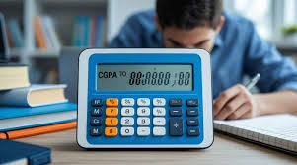

Introduction to Student Average Calculator
Purpose
Target Audience
Significance
To calculate the average of marks entered by the user & Helps students keep track of their academic performance
Students of all educational levels.
Reduces manual calculation errors, Saves time and provides instant results.

Slide 3
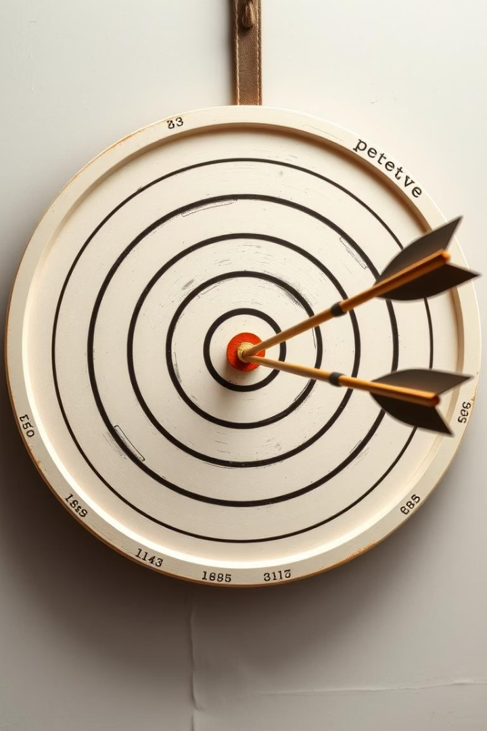
Objectives of Student Average Calculator
1. Develop a Java-Based Tool To create a program that calculates the average of marks entered by the user
2. Simple User Interface To provide a clean and easy interface for entering marks and viewing calculated averages.
3. Demonstrate Java Concepts To practically implement Java fundamentals like loop
arrays, conditional statements, and optionally GUI components.
4. Ensure Accuracy and Efficiency To build a reliable and efficient system that handles multiple inputs correctly and displays accurate results.

Slide 4
System Architecture of Student Average Calculator
Client Side
Server Side
. Business Logic Layer
Processes the input using core Java logic – calculates
the total marks and average, possibly using loops, methods,
and arrays or ArrayLists
. User Input Interface The client interacts with the system via the console or GUI,
entering the number of subjects and corresponding marks.
. Input Validation Performs initial checks on the data entered
before sending it for processing.
. Result Generation Generates the output based on the processed data
and sends it back to the client for display

Slide 5

Working of the Student Average
Calculator System
1. Start the Program The Student runs the Java program from the console or GUI.
2. Enter login Details The Student enters login Details
3. Enter Division The Student enters Division
4. Enter Student Data (Roll no. , Name, Marks) The Student enters their data
5. Display Result The total marks , percentage & Grade and are displayed to the student
including student data.

Slide 6
Java Concepts Used in Student Average Calculator
Object-Oriented Programming
Exception Handling
Collections Framework
. AWT
. Swing
. ArrayList
. Classes & Objects to represent students
and their marks
. Collections
. Encapsulation to protect and manage data
using private variables and public methods.

Slide 7
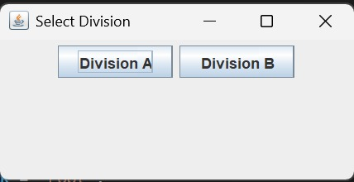
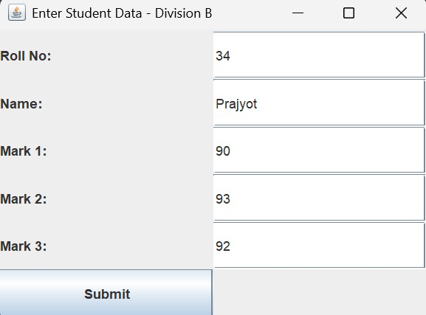
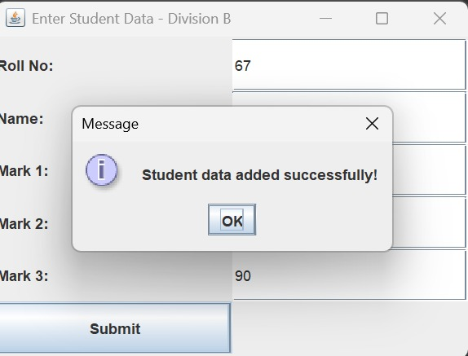
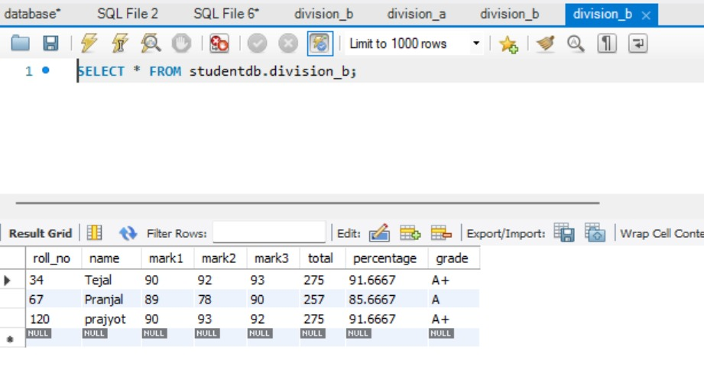
Step1:
Step2:
User Interface Design Highlights
Step3:
Responsive Layout
Interactive Elements
Accessible on multiple devices and resolutions
Buttons, timers, and progress indicators
Step4:
Accessibility Features
Keyboard navigation and screen reader support

Slide 8

Key Takeaways & Future Directions
Practical Java Implementation
Successfully developed a working Java application to calculate students’
average marks.
Logical Programming Skills
Improved logic building through use of loops, methods, and
modular code design.
Input-Processing-Output Flow
Gained experience in managing user input, data processing,
and result display in a structured format.

